Slide 1
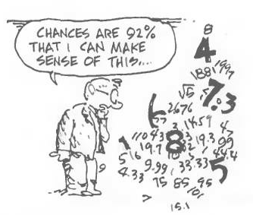
Graphical Representations
Chapter 2
Part 1
Dr. Abolfazl Saghafi
Assistant Professor of Statistics & Data Science
Data Science Program Director
Notes:
After data collection, we end up with a pile of numbers. In this chapter we learn about different methods to present these numbers to convey useful information. These techniques are known as descriptive statistics or exploratory analysis which are the second components of a statistical process.

Slide 2
Small Datasets
* Stem-and-Leaf Plot can be used for continuous data as well
Sample size less than 25 is usually considered small
If the number of data points (sample size) is relatively small, we may use the following methods to summarize information of the gathered data discrete quantitative data
Dot Plot
Stem-and-Leaf Plot
Frequency Tables
Example. The following represent the number of tickets a group of friends have received since they got their driver’s license!
3 6 6 6 4 3 3 6 7 5 7 5 5 8 3 5 5 5 2 5
Notes:
There are three available options to summarize discrete quantitative data when sample size is small. Dot Plot, Stem-and-Leaf Plot, and Frequency Tables.

Slide 3
Dot Plot / Frequency Table
We can obtain the Frequency Table or t-table by simply representing the outcomes and frequencies in a table
The dot plot indicates both the outcomes and their frequency; that is the frequency distribution. To graph a dot plot
1. Sort the data:
2 3 3 3 3 4 5 5 5 5 5 5 5 6 6 6 6 7 7 8
x
freq.
2. Mark the data on real line with dots over representing the frequency of each outcome:
2
1
3
4
4
1
frequency
7
5
6
4
7
2
8
1
outcomes
2
3
4
5
6
7
8

Slide 4

Stem and Leaf Plot
Using dot plot for continuous data like the following does not make sense. Why? Instead, a stem & leaf plot is used.
1.25 1.34 1.47 1.27 1.29 1.31 1.35 1.36 1.42 1.20 1.45 1.39
1. Construct of a column of stems; this is subjective to the range of numbers. For example, if they range from 100 to 150, the hundreds and tens could be stem.
2. Read the data values once at a time, place each leaf on the appropriate stem.
3. Sort the leaves.
Stem – units and tenths place
Leaf – the hundredths place
1.2 | 0, 5, 7, 9
1.3 | 1, 4, 5, 6, 9
1.4 | 2, 5, 7
►
Notes:
If we build a dot plot for continuous data, then we usually have one dot or maybe two above a bunch of different numbers, that does not provide a useful summary. A better approach for continuous data is to group a range of numbers together, just like above.

Slide 5
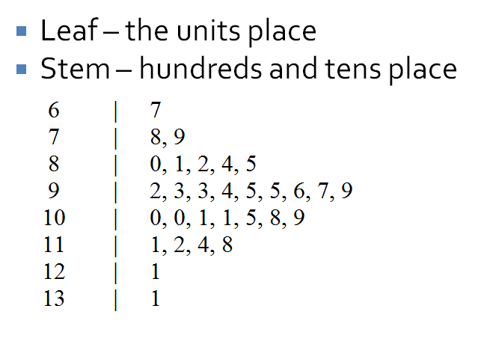
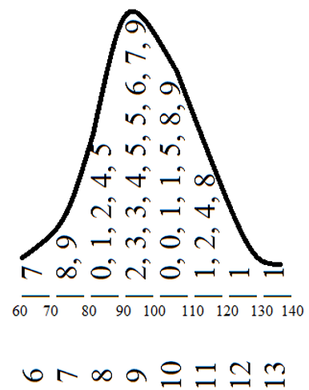
Example
The following information was obtained from an experiment. Summarize the data in a Stem & Leaf plot.
97, 96, 95, 112, 95, 105, 109, 101, 93, 80, 82, 85, 111, 67, 79, 109, 114, 78, 101, 101, 84, 92, 131, 94, 121, 108, 93, 100, 100, 118
By rotating the stem-and-leaf 90 degrees to the left, we see the frequency distribution of the data.
Notes:
You can proceed without sorting but sorting always helps

Slide 6
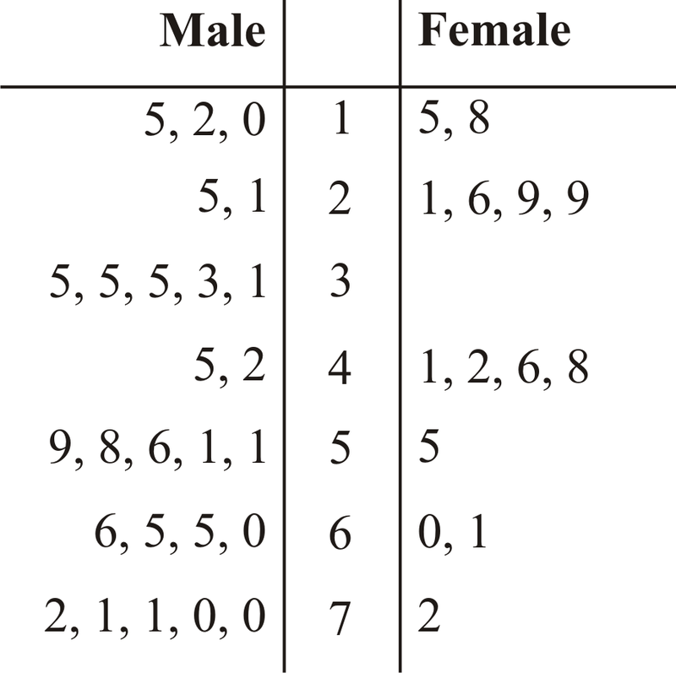
Question
We can graph a back-to-back stem & leaf plot if data is gathered on two variables, one quant and one qual with two categories. Example:
Given the following Stem-and-Leaf plot for recorded temperatures in October,
1. How many temperatures are recorded?
2. What was the highest recorded temperature?
Stems
Leaves
4
8
5
2
7
4
5
1
0
3
6
0
2
5
7
7
4
2
0
1
Notes:
Answer: count the number of leaves to find the recorded temperatures. The leaves are not sorted, investigate the chart to find the minimum and maximum recorded temperatures.
If we have two datasets roughly with the same range of values we can draw a back to back Stem & Leaf plot which makes their comparison easier.

Slide 7
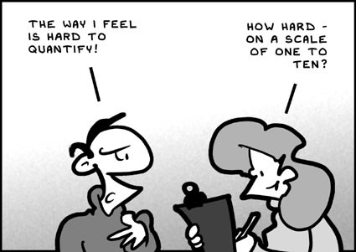
Graphical Representations
Qualitative Variables
Frequency
Table
Graphs
Bar Chart (Pareto/Pictograph)
Pie Chart
Tree Diagram

Slide 8
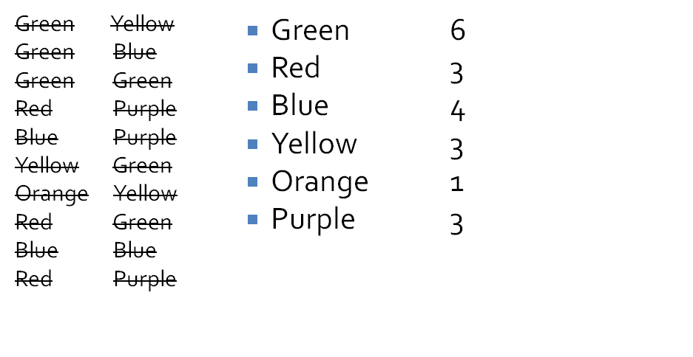
Frequency Distribution
A frequency distribution is a tabulation of the values that one or more variables take in a sample.
Relative
freq.
(%)
Cumulative
Freq.
Relative
freq.
Relative
Cum. Freq.
freq.
6
6/20
30
6/20
9
3/20
15
9/20
13
4/20
20
13/20
16
.
.
.
15
.
.
.
17
5
20
15
Sum
20
Notes:
See the animation in the slide if you didn’t get it

Slide 9
Step-by-Step Frequency Tables
1. Construct a column of the different data values in ascending order.
2. For each data value, count the number of times each value occurs and write in frequency column.
Using the sum of the frequencies, we can verify that we have included all the data points since the Sum should be equal to sample size.
Using the frequencies, compute the cumulative frequencies; that is, c_{i}=f₁+f₂+…f_{i} for i=1,2,..,k, where k is the number of distinct outcomes.
5. create a column for Relative frequencies; that is, given that the frequency of a given outcome is f_{i} and the sample size (sum of frequencies) is n then the relative frequency is f_{i} / n.

Slide 10
Question
Different
Data Values
Cumulative
Frequency
Relative
Frequency %
Complete the given frequency table.
Frequency
x | f | F | r (%)
9 | 4 |  | 8
10 |  | 11
11 |  |  | 26
12 |  | 34 | 20
13 |  | 50
 | 50 |  | 100
Sum
Notes:
Answer:
9 4 4 8
10 7 11 14
11 13 24 26
12 10 34 20
13 16 50 32

Slide 11
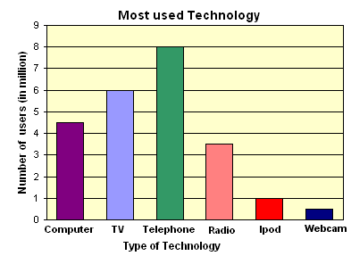
Bar Chart
Step-by-Step Bar Chart
1. Create a frequency table, should have at least class marks and frequency column
2. Mark different categories on the horizontal axis
3. Construct rectangles with heights proportional to the frequency/relative frequency, leaving gaps between the various categories
A bar chart is a representation of a frequency distribution of a qualitative variable by way of rectangles whose heights are proportional to relative frequencies placed over each category.

Slide 12
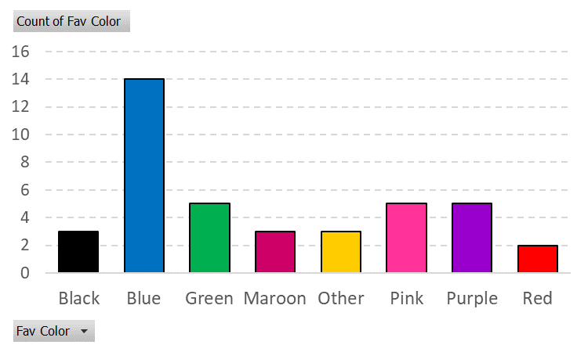
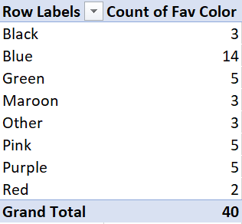
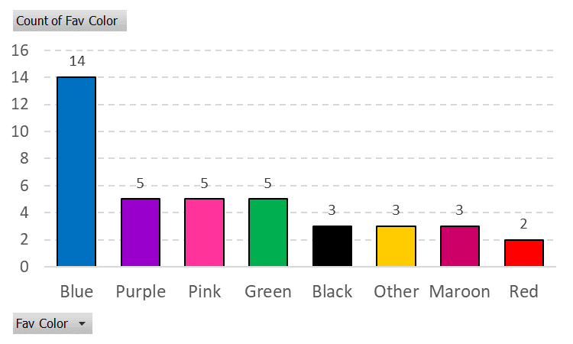
Pareto Chart
A Pareto chart is a bar chart such that the categories have been sorted according to frequency (in descending order).

Slide 13
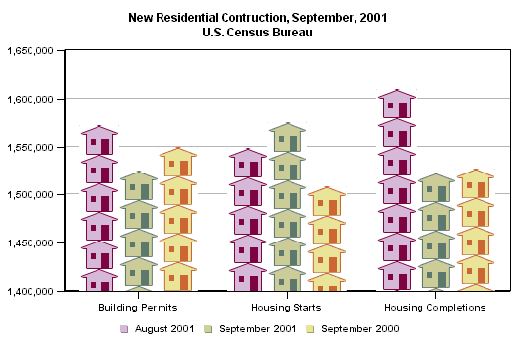
Pictogram
Example. The US Census Bureau uses houses to indicate the number of new residential constructions in August 2001 and September 2000-2001.
Pictogram is a pictorial representation of frequencies, especially when each value is represented by a proportional number of pictures.

Slide 14
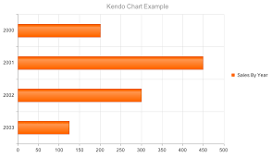
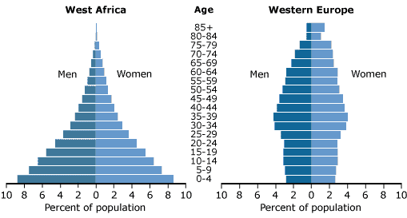
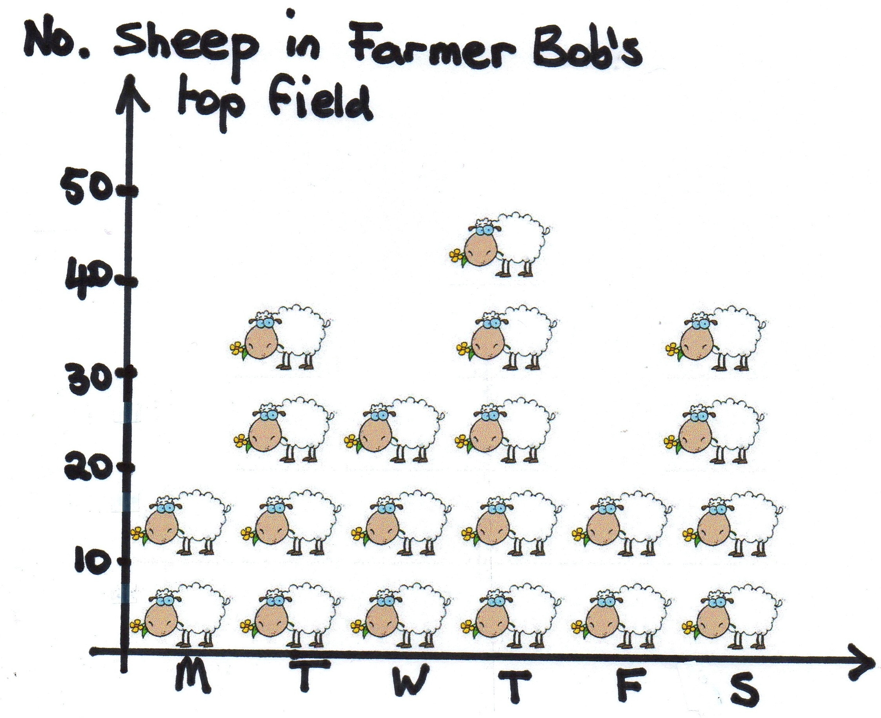
Examples of Bar Charts
Notes:
You can graph horizontal bar charts too, even have side by side bar charts

Slide 15
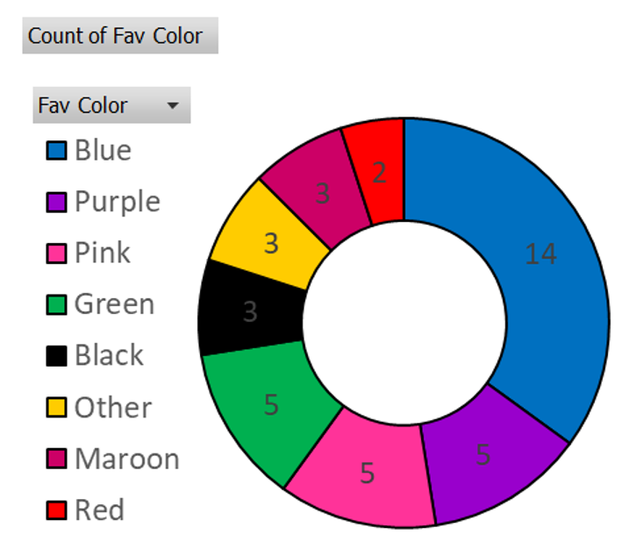
Pie Chart
A Pie Chart is a circle divided into categories where the size of each category is proportional to the frequency of the outcome.
1. Construct a frequency table having different data values, their frequencies and relative frequencies.
Given that the frequency of a given outcome is f and the sample size (sum of frequencies) is n, the relative frequency is r = f / n
2. Compute the angle for each category by multiplying each relative frequency by 360, that is Angle = r × 360°. Apportion the circle using the values in the angle column.
Notes:
Add the angles next to the frequencies in the table. For the Black color the angle is 3/40*360

Slide 16
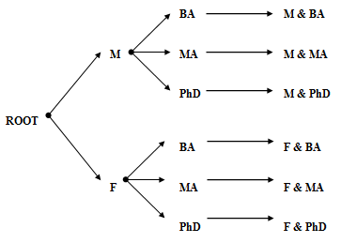
Tree Diagram
Gender
Degree
Frequency
F
BA
2
F
MA
3
A tree diagram is a network diagram used to illustrate various outcomes in a multi-stage experiment.
F
PhD
1
M
BA
1
M
MA
3
M
PhD
0
1. Starting at root, create branches according to the possible outcomes of the first variable.
2. From each of the outcomes created above, create additional branches according to the categories of the second variable. Repeat as needed.
Notes:
A tree diagram visually shows the variables and their different categories

Slide 17
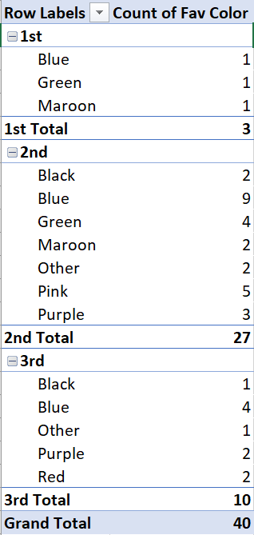
Exercise
When graphing ANY chart do NOT forget to
• Include a title
• Label axis clearly with characteristic described by the variables
• Include units of measure
Generate a Pie Chart for variable YEAR
Notes:
Do the exercise with paper and pencil
Year f. r.f. a.
1st 3 3/40 27
2nd 27 27/40 243
3rd 10 10/40 90
Sum 40 1 360

Slide 18

Practice Problems Part 1
1. Researchers recorded the following 15 survival times (in days) of lab rats infected with a deadly bacillus in a test of resistance to infection. Construct a stem-and-leaf plot for the survival times.
2.9 | 4.3 | 4.6 | 5.2 | 5.4 | 5.4 | 5.5 | 5.6 | 5.9 | 6.0 | 6.2 | 6.6 | 6.7 | 6.9 | 7.0
2. The following table contains the left ventricular ejection fraction (LVEF) for 13 patients with acute dilated cardiomyopathy (ADC) and 13 healthy patients (control group). Provide a frequency distribution table and an appropriate graphical summary for the qualitative variable.
Notes:
It’s your turn now, practice what you’ve learned today. Check out the book or online resources if you want to see more examples.
Answers are provided in Ch2 Practice Problem Solutions

Slide 19

Practice Problems Part 1
3. The ages of females and males who died of sudden cardiac causes after 4:31 am on the day of the Northridge Earthquake are given below.
Construct a frequency distribution table that describes the composition of the sample with respect to gender.
Draw an appropriate graphical summary (clearly label the graph).
Construct a stem-plot for Age (ignoring gender).
Construct a back-to-back stem-plot for Age of the two genders.
Female | 77 | 83 | 75 | 77 | 70 | 80 | 68 | 58 | 70 | 81 | 78 | 69 | 38
Male | 90 | 38 | 45 | 47 | 79 | 75 | 71 | 68 | 51 | 55 | 66 | 56 | 59 | 60 | 68 | 64 | 53 | 90
Notes:
Answers are provided in Ch2 Practice Problem Solutions

